Slide 1
JNCIS-ENT
Open Shortest Path First (OSPF)

Slide 2
LSA Types and Realms
6
Distributing information in OSPF

Slide 3
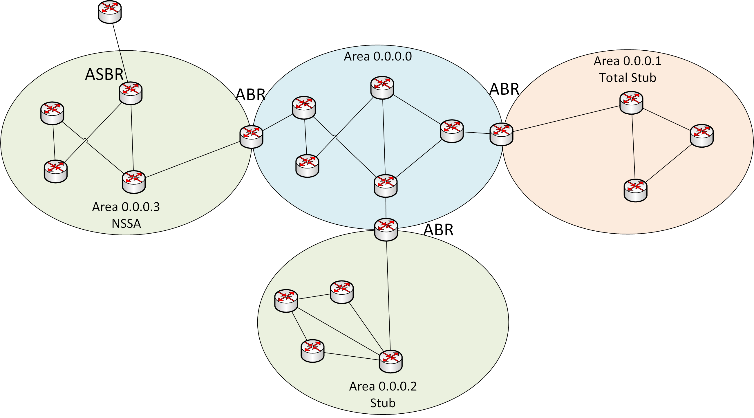
OSPF LSA Types Overview
6 LSA types are typically used in OSPF
Router LSA (Type 1)
Area scope
Generated by every router
Network LSA (Type 2)
Area scope
Generated by DR
Summary LSA (Type 3)
Area scope
Generated by ABR
ASBR LSA (Type 4)
Area scope
Generated by ABR
External LSA (Type 5)
Domain scope
Generated by ASBR or ABR*
NSSA External LSA (Type 7)
Area scope
Generated by ASBR
Notes:
Type 5 only generated by an ABR when converting a type 7

Slide 4
OSPF Areas Review
Areas allow for partitioning of routing information into smaller sections
Summarization may only be done at area boundaries
An interface of a router is wholly in an area, an ABR has interfaces in multiple areas
Several types of areas exist in OSPF:
Backbone area / general area
Stub area
Not-so-stubby area
Total stub area
LSA Area | Type 1 | Type 2 | Type 3 | Type 4 | Type 5 | Type 7
Backbone | yes | yes | yes | yes | yes | NO
General | yes | yes | yes | yes | yes | NO
Stub | yes | yes | yes | NO | NO | NO
Total Stub | yes | yes | NO* | NO | NO | NO
NSSA | yes | yes | yes | NO | NO | yes
Notes:
In total stub, a default route type 3 is still originated

Slide 5
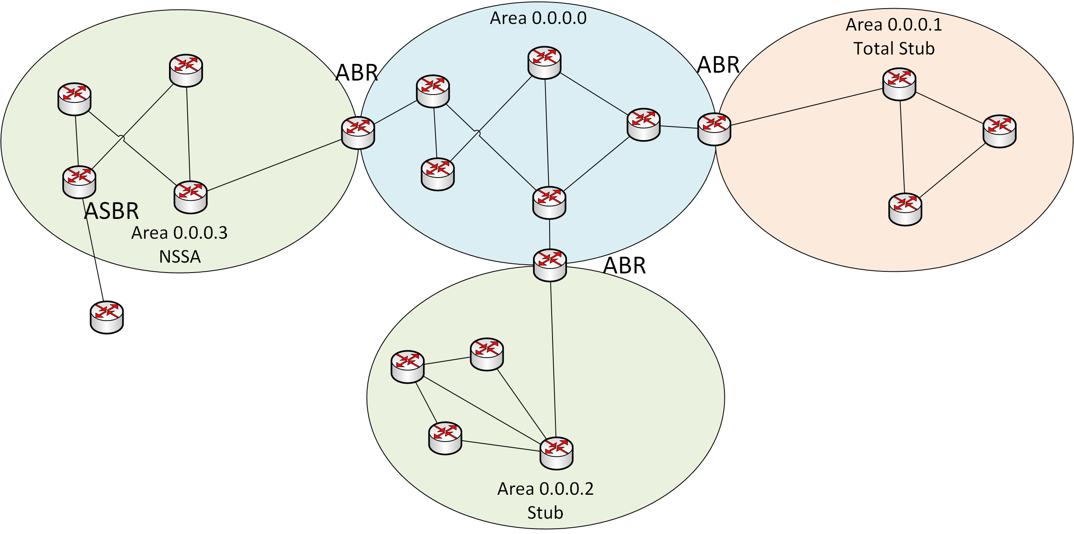
Type 1 – Router LSA
Every router in an OSPF domain generates a Type 1 LSA
Type 1 LSAs include the following information:
Directly connected subnets
Fully adjacent neighbors
Type 1 LSAs are only flooded within the area

Slide 6
Type 2 – Network LSA
Type 2 LSAs are only generated by Designated Routers (DRs)
These LSAs describe all routers on the segment
Non-broadcast segments will not have a Type 2 LSA due to no DR
Type 2 LSAs are only flooded within the area

Slide 7
Type 3 – Summary LSA
Type 3 LSAs are only generated by ABRs
These LSAs are inter-area routes, meaning routes from areas other than the local area
Summary LSAs do not summarize routing information
ABRs convert information learned from type 1 and 2 LSAs to a type 3 and flood to other areas

Slide 8
Type 4 – ASBR Summary LSA
Type 4 LSAs are much like Type 3 LSAs in that they are flooded by an ABR and derived from information learned in other LSA types
Type 4 LSAs describe reachability information to an ASBR
No external routes are included in a Type 4, only reachability to the ASBR itself
These LSAs originate from an ASBR and have area scope

Slide 9
Type 5 – External LSA
Where Type 4 LSAs describe how to reach an ASBR, the Type 5 LSA describes what external routes are reachable through a given ASBR
An ASBR in a backbone or general area will generate Type 5 LSAs directly
When an ABR receives a Type 7 LSA, it will convert the LSA to a Type 5 and flood into the backbone area
Type 5 LSAs have domain scope

Slide 10
Type 7 – NSSA External LSA
Type 7 LSAs contain the same information as Type 5 LSAs
Type 7 LSAs are generated by ASBRs located in an NSSA area and have area scope
When the ABR receives the Type 7 LSA, it will convert it to a Type 5 LSA and flood to the rest of the OSPF domain

Slide 11
OSPFv3 and Realms
OSPFv2 can only carry IPv4 routing information
OSPFv3 was introduced to distribute IPv6 routing information
OSPFv3 is a separate routing protocol configured in the [edit protocols ospf3] hierarchy
Realms allow OSPFv3 to carry additional address families than just IPv6 Unicast routes:
IPv4 unicast
IPv4 multicast
IPv6 multicast
Notes:
*DR and BDR will be explained in the next video

